Slide 1
Bank Loan Prediction
Using Machine Learning
Nayan Dey
ID:2104010202216

Slide 2
Outline
1.Introduction
5.Web System
2.Dataset Description
6.Conclusion & Future Work
3.Methodology
7.References
4.Results and Analysis

Slide 3
Introduction
Loans play a major role in the banking system, but checking loan applications manually takes time and can lead to mistakes. Banks need a faster and more accurate way to decide who should receive a loan.
In this project, I developed a machine learning model that predicts loan approval based on applicant data. I also created a web application that allows users to enter their information and instantly see the prediction.

Slide 4
Dataset Description
Overview
Key Features
Preprocessing
Source: Kaggle Bank Loan Dataset
Records: 614
Features: 13
Applicant Income, Co-applicant Income, Loan Amount, Credit History, Marital Status, Education.
Fill Missing values
categorical encoded
SMOTETomek for balance
features scaled

Slide 5
Methodology Workflow
Data Split
80% train data,20% test data
Sampling
Hybrid SMOTETomek for class balance
Scaling
StandardScaler for normalization
Training
RF,DT,
Bagging,
Gradient Boosting
Evaluation
Accuracy, Roc, Confusion matrix

Slide 6
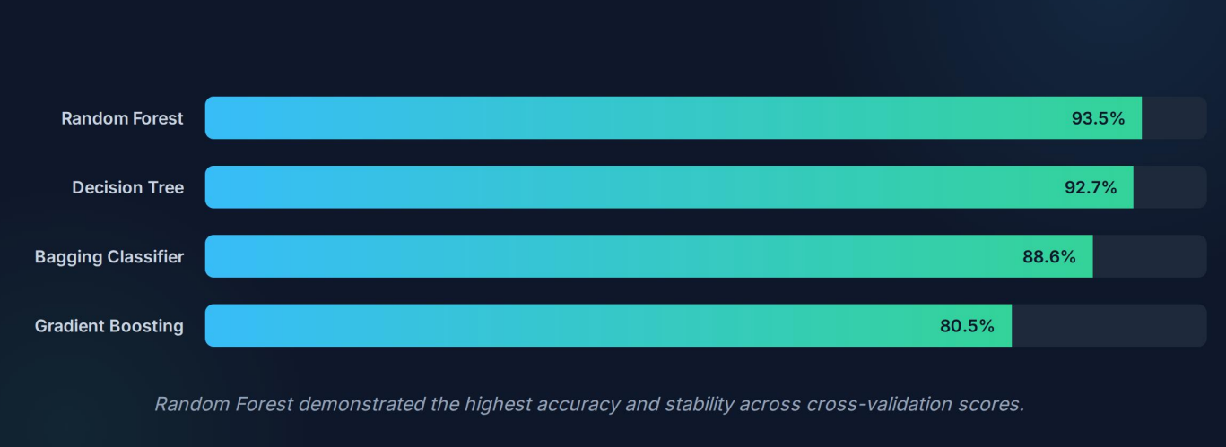
Results & Analysis

Slide 7
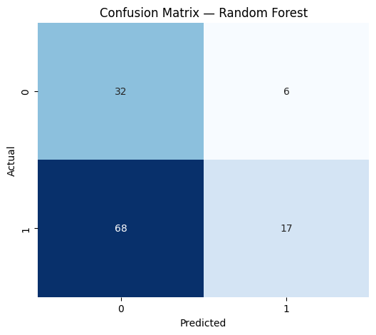
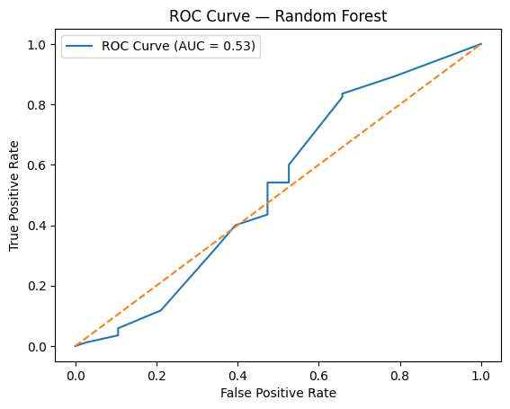
Results & Analysis

Slide 8
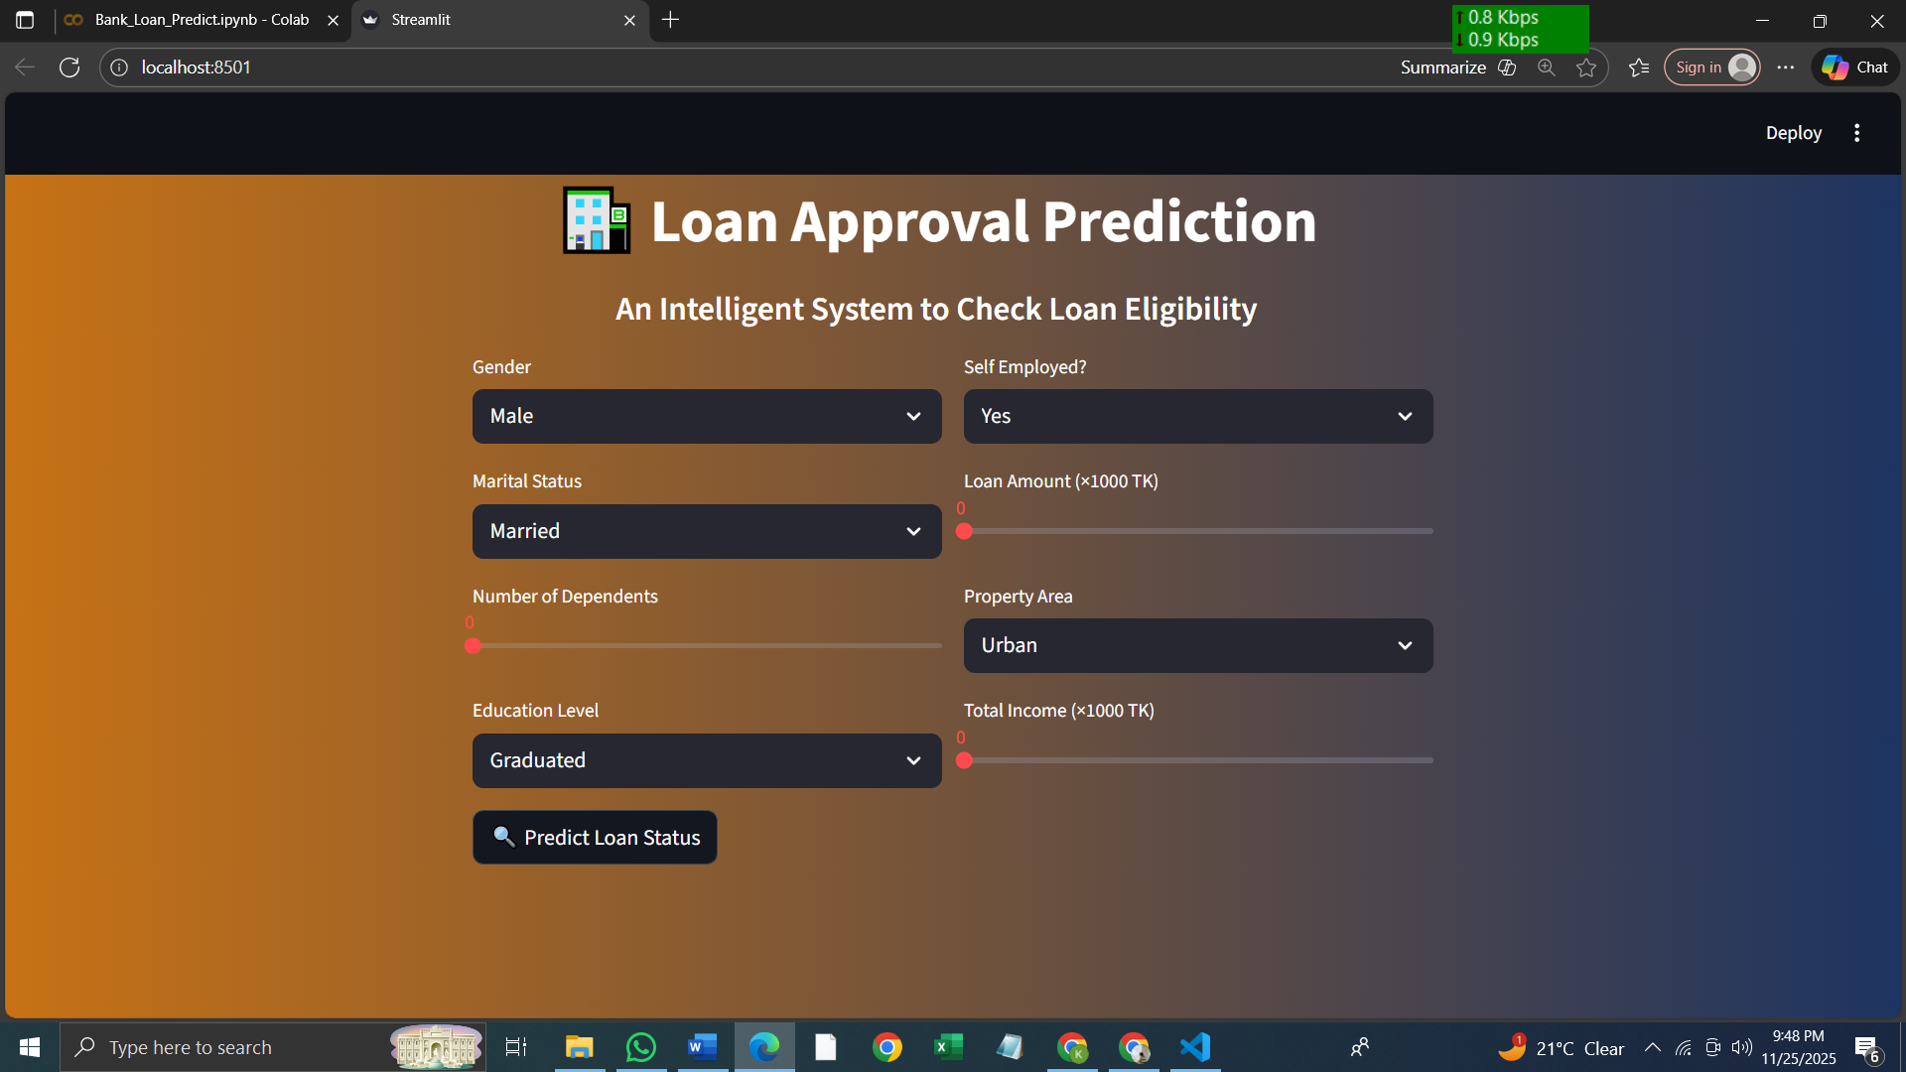
Web System

Slide 9
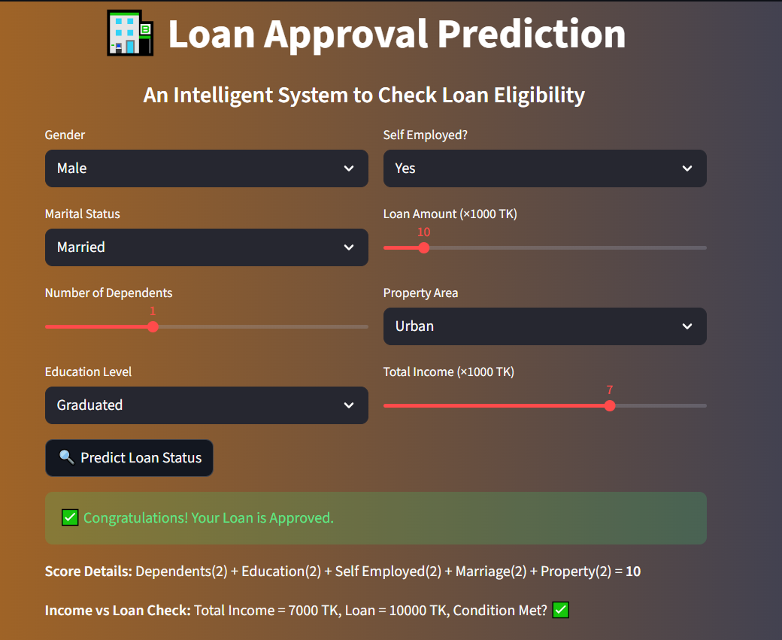

Slide 10
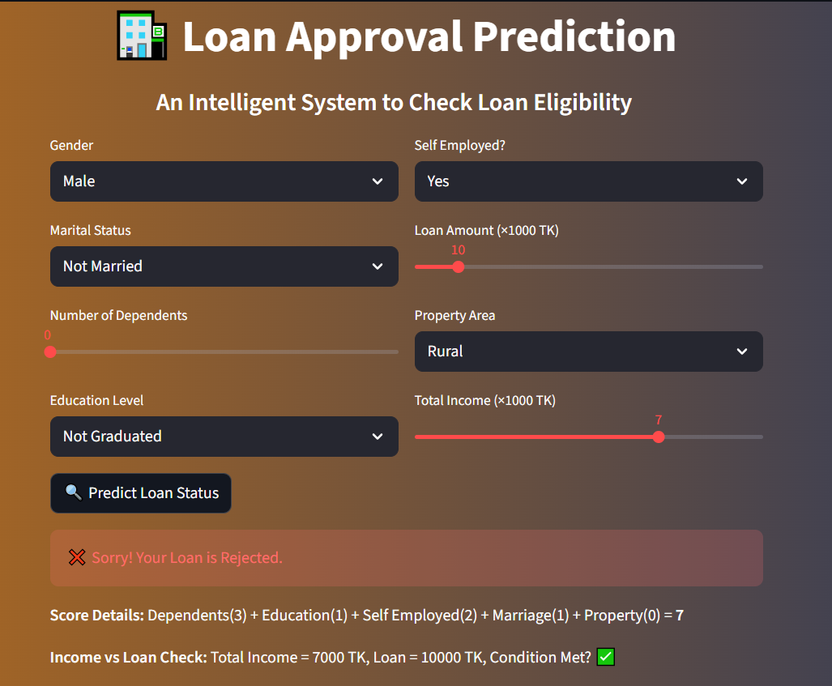

Slide 11
Conclusion
Built a machine learning system to predict loan eligibility.
Random Forest gave the best results (high accuracy, stable CV, strong ROC-AUC).
Helps banks save time, reduce errors, and make fair decisions.
Web app allows real-time predictions.

Slide 12
Future Work
Add more features
Try advanced models
Connect to live data
Make predictions explainable

Slide 13
References
Kaggle. (n.d.). Bank Loan Prediction Dataset. Retrieved from https://www.kaggle.com
Pedregosa, F., Varoquaux, G., Gramfort, A., Michel, V., Thirion, B., Grisel, O., ... & Duchesnay, É. (2011). Scikit-learn: Machine Learning in Python. Journal of Machine Learning Research, 12, 2825–2830.
3. Chawla, N. V., Bowyer, K. W., Hall, L. O., & Kegelmeyer, W. P. (2002). SMOTE: Synthetic Minority Over-sampling Technique. Journal of Artificial Intelligence Research, 16, 321–357.
4. Breiman, L. (2001). Random Forests. Machine Learning, 45(1), 5–32.
5. Friedman, J. H. (2001). Greedy Function Approximation: A Gradient Boosting Machine. Annals of Statistics, 29(5), 1189–1232.

